Slide 1
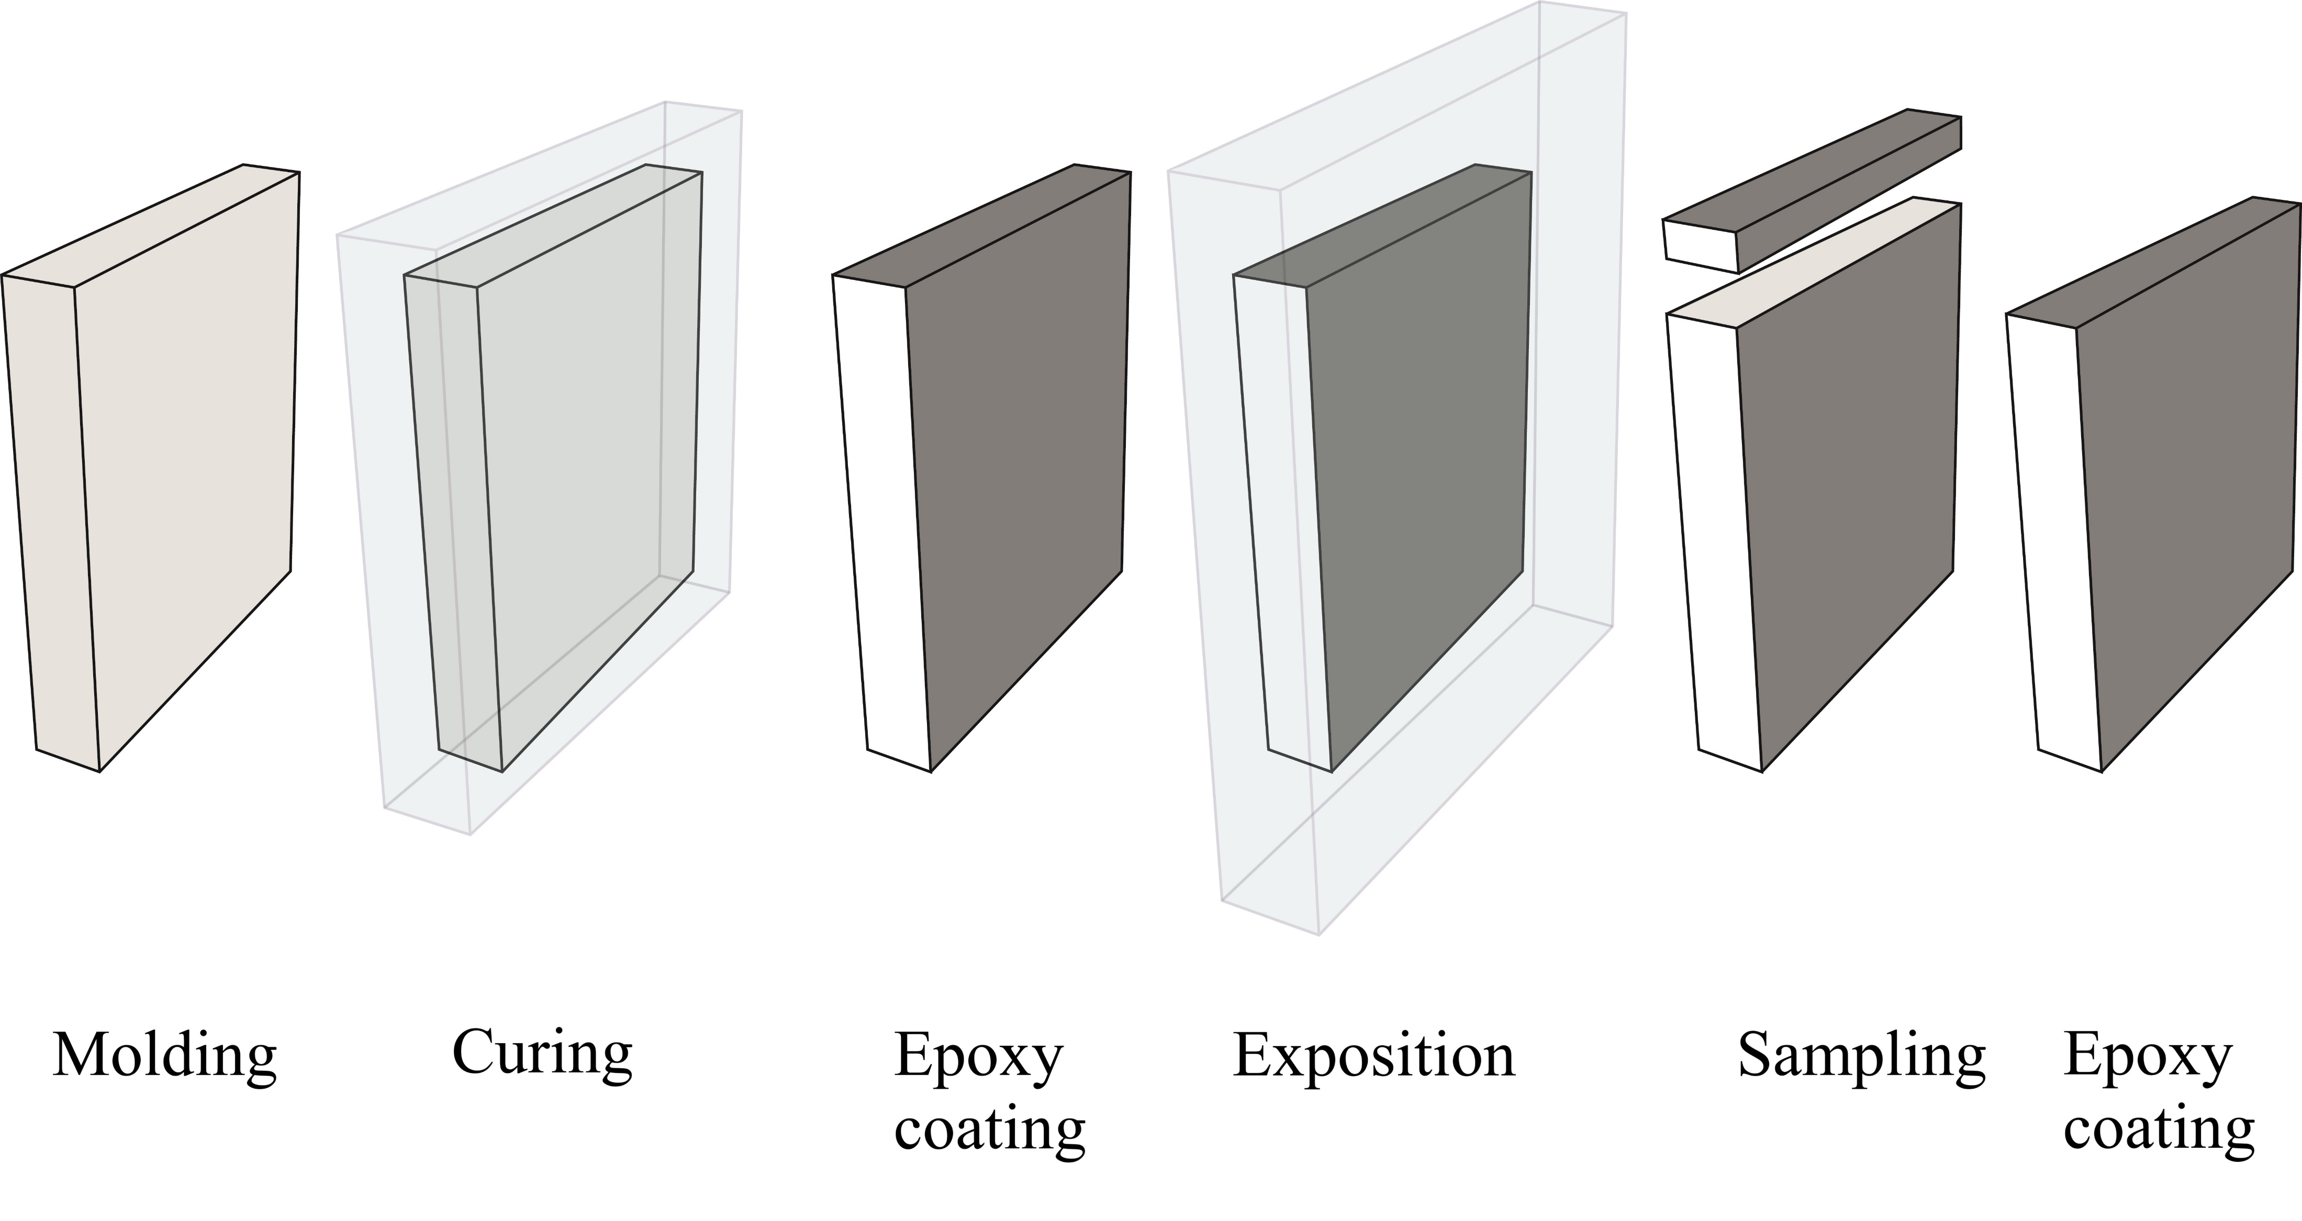
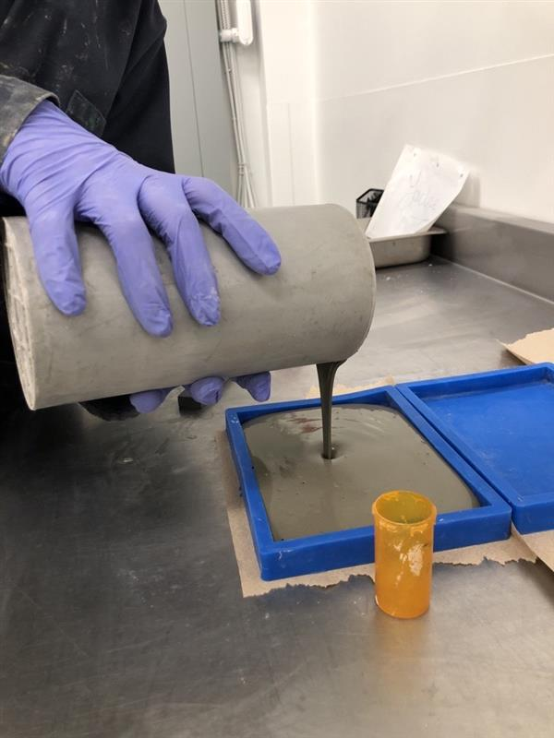
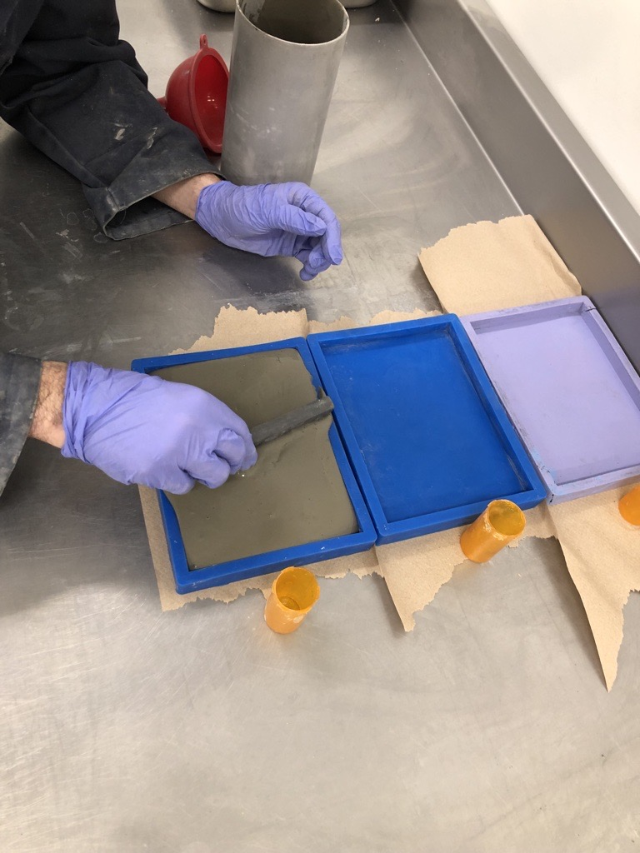
Sample preparation:
Preparation of cement paste scale sample to facilitate the development of the test methods.
Notes:
Objectif carboneutralié

Slide 2

Curing:
The objective is to ensure a complete, reproducible hydration of the microstructure that corresponds to real-life condition. In chloride ingress, the sample is commonly kept saturated to prevent chloride ingress by advection.
Notes:
Objectif carboneutralié

Slide 3
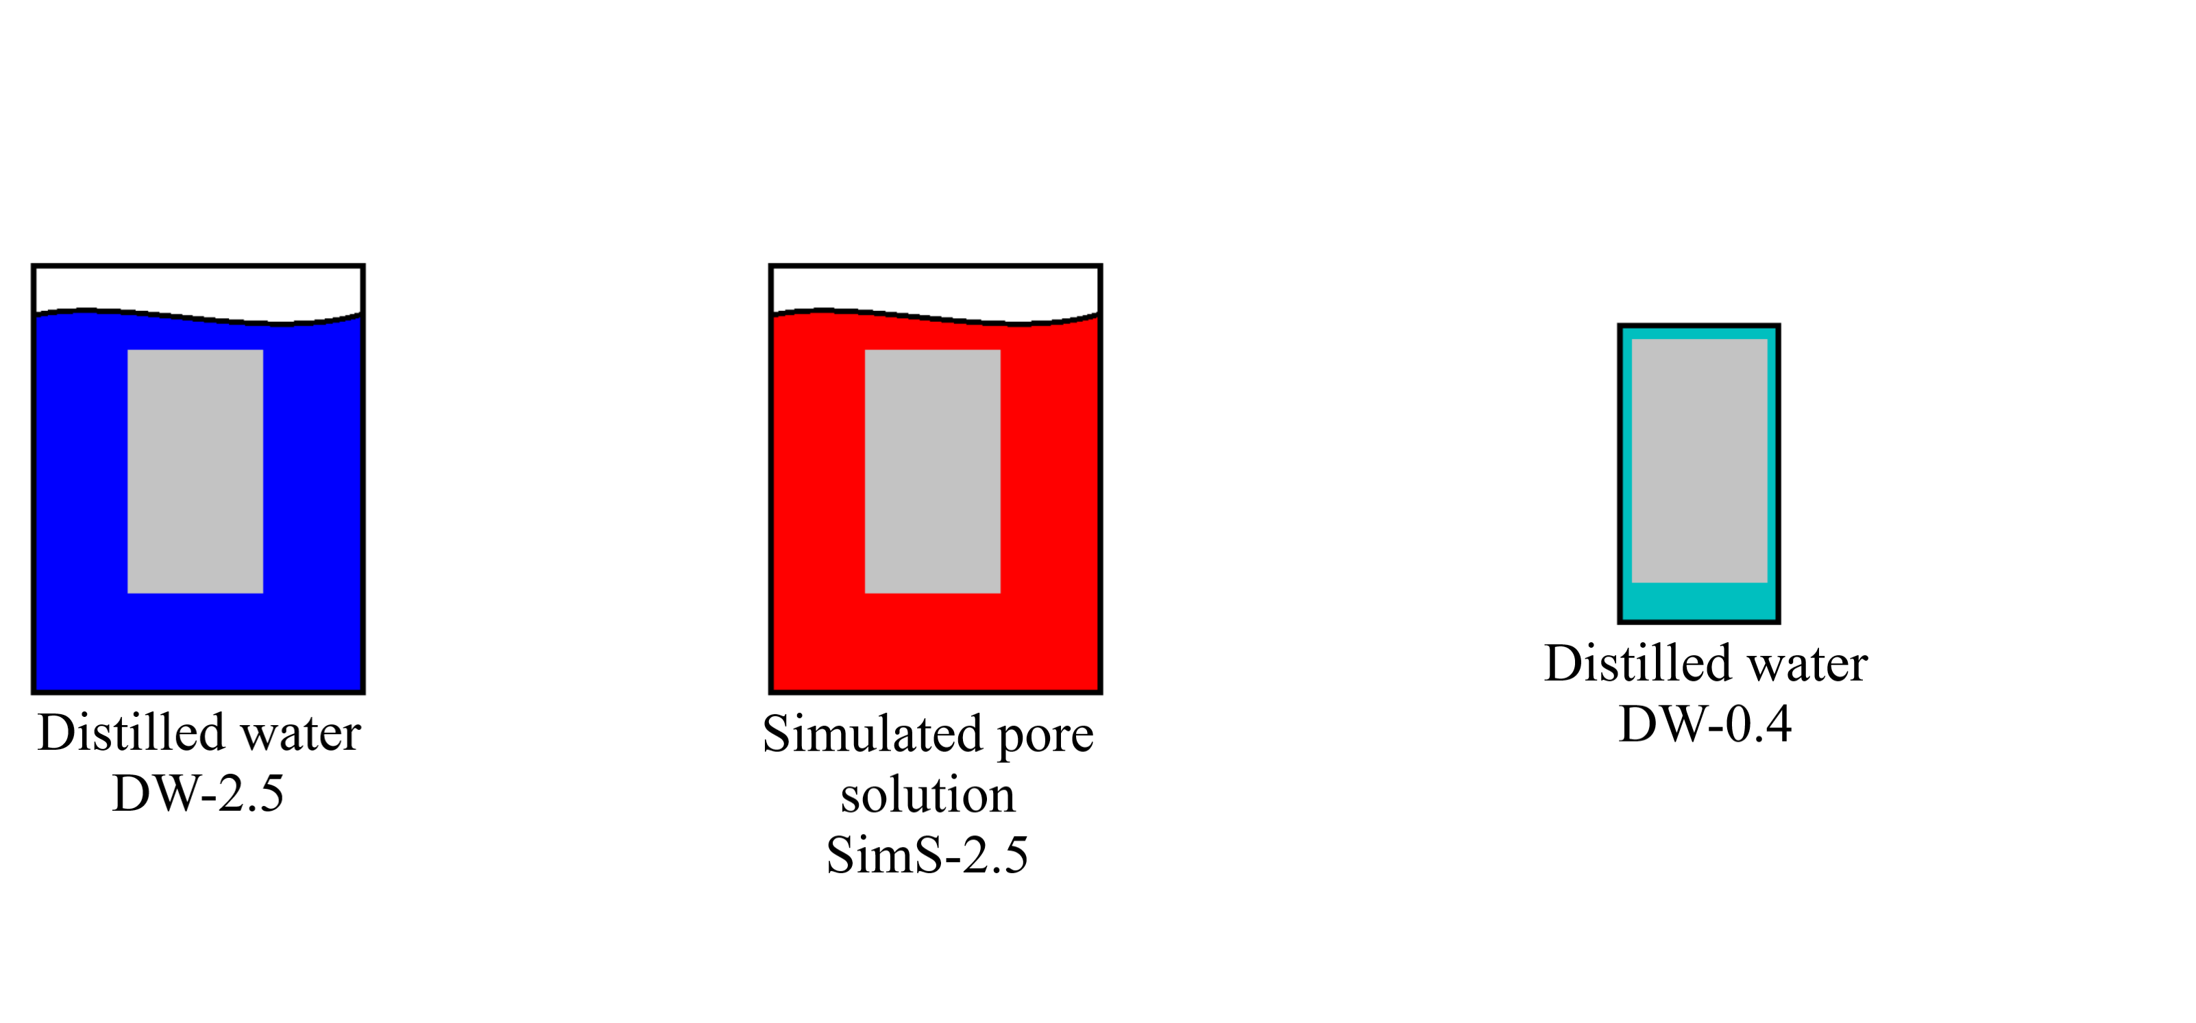
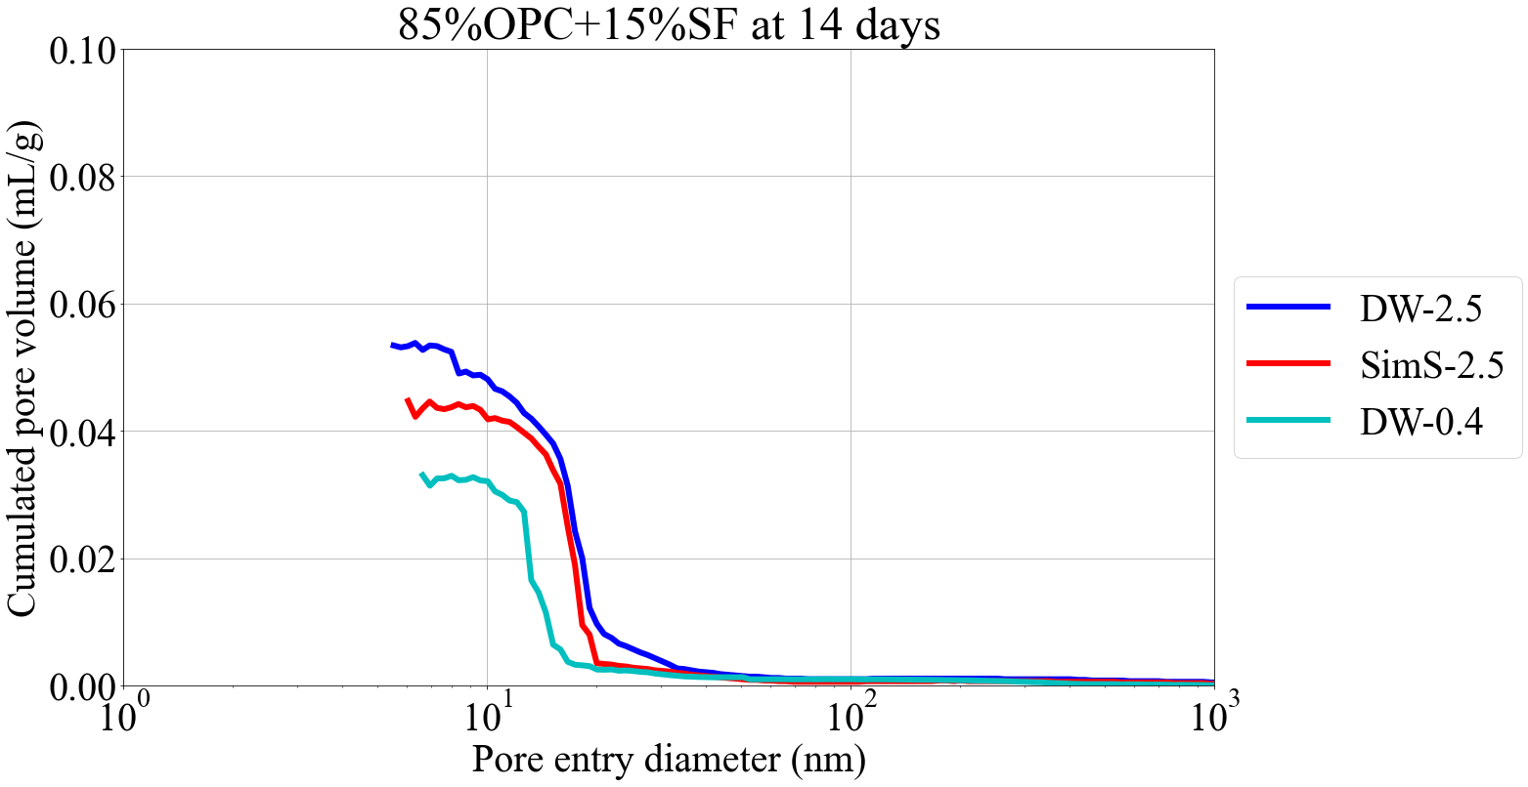
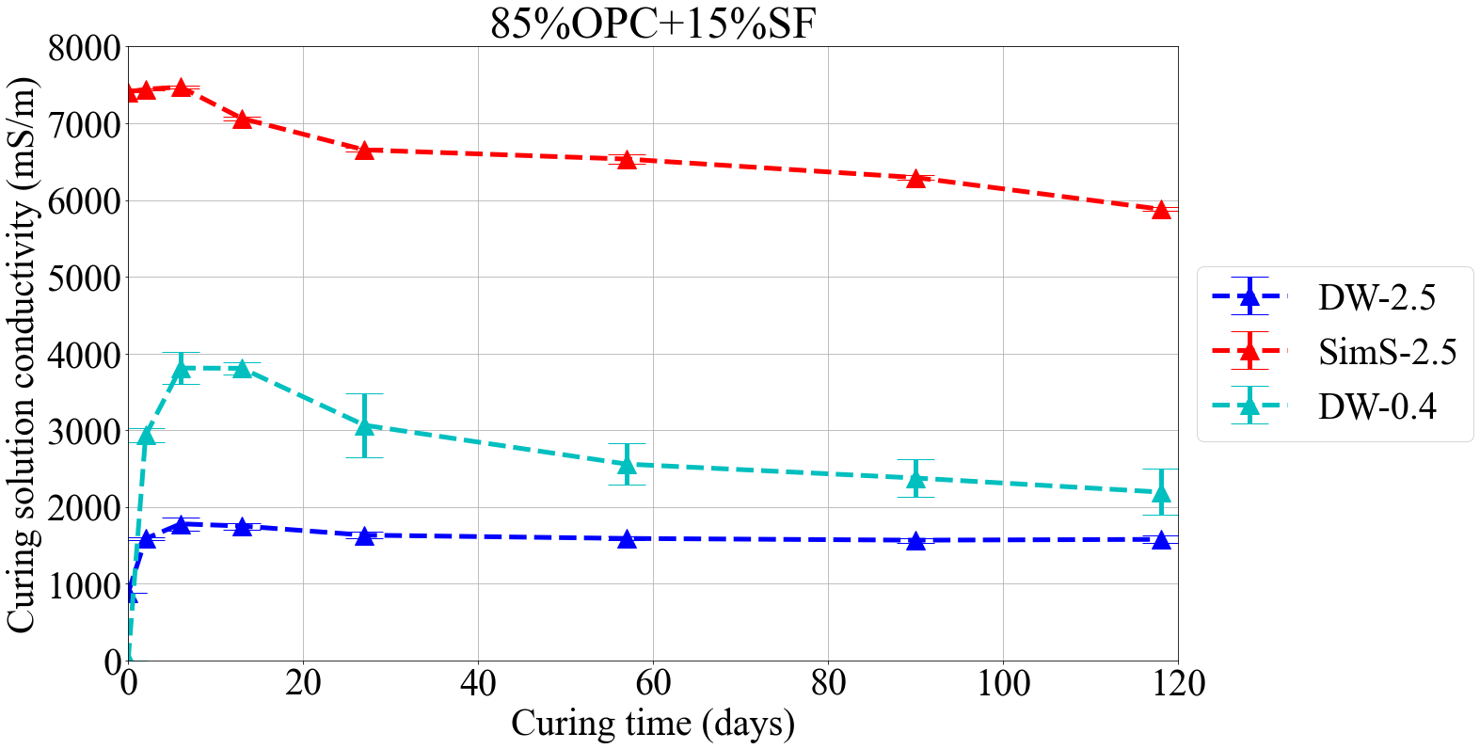
Part 1: curing solution
Main findings:
Curing in alkaline solution accelerates the hydration
Common simulated pore solution not adapted to low-pH cement paste
Small amount of water best compromise
T. Bernard and W. Wilson, Comparison of curing methods for bulk electrical conductivity testing of cement pastes, Materials and Structures, 2025-05, DOI: 10.1617/s11527-024-02558-w
Notes:
Objectif carboneutralié

Slide 4
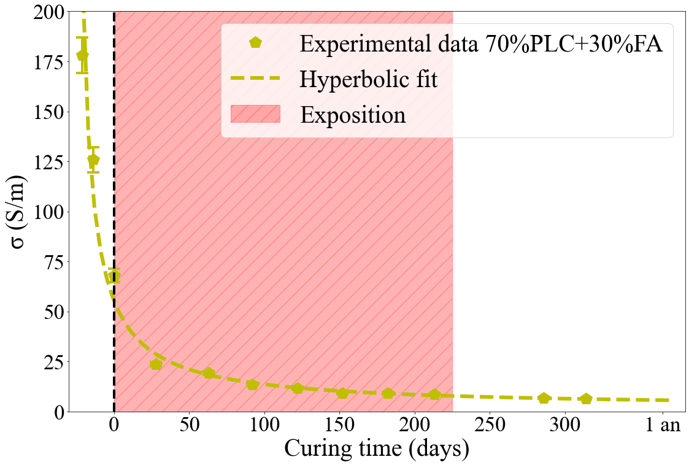
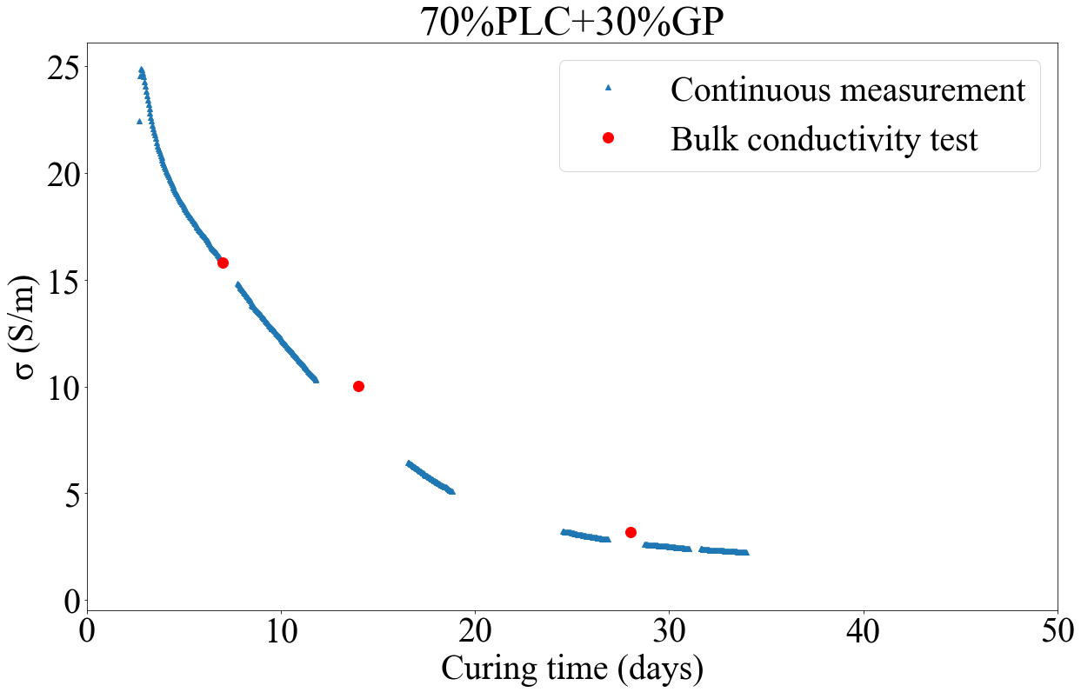
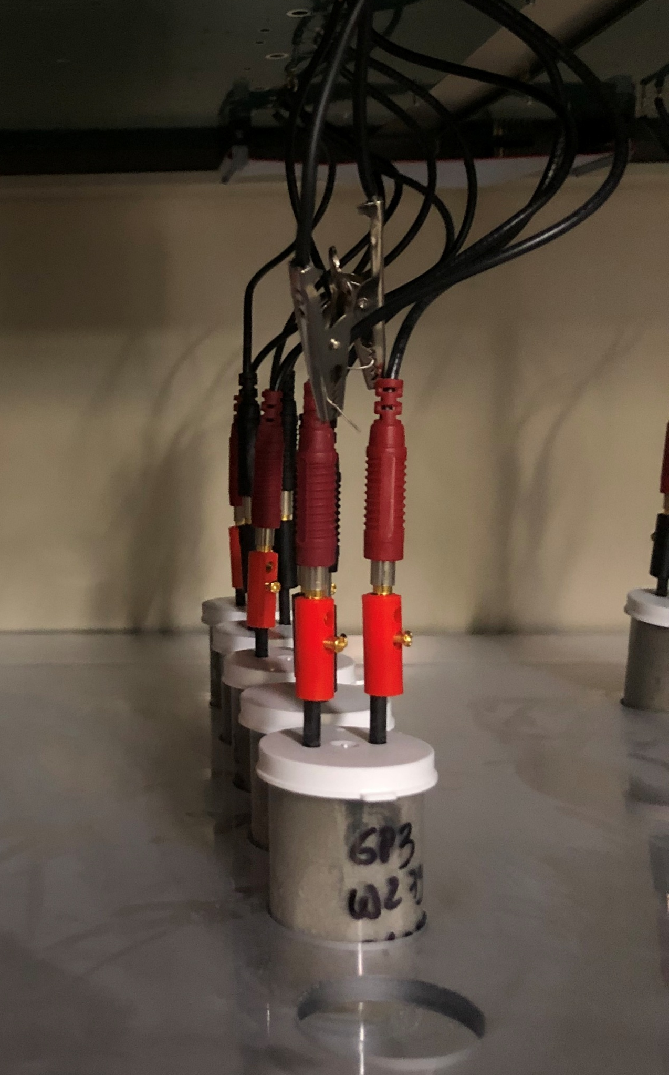
Part 2: curing duration
Main findings:
Exposure after 28 days might be on hydrating cement paste (visible by following the conductivity) which prevents the applicability of Fick’s law
Inverse of the hyperbolic law can be used to fit the evolution of the conductivity and predict its stabilisation time
T. Bernard and W. Wilson, Predicting the Microstructure Stabilization Time from Electrical Resistivity Measurements, In Proceedings of the 12th ACI/RILEM international conference on cementitious materials and alternative binders for sustainable concrete, Toulouse 2024.
Development of an automatic electrical conductivity measurement based on embedded electrodes to obtain high frequency data.
Notes:
Objectif carboneutralié

Slide 5
Exposure:
The objective is to allows a unidimensional diffusion of chloride in the sample. The exposure must correspond closely to real-life condition while maintaining a simple protocol.
Notes:
Objectif carboneutralié

Slide 6
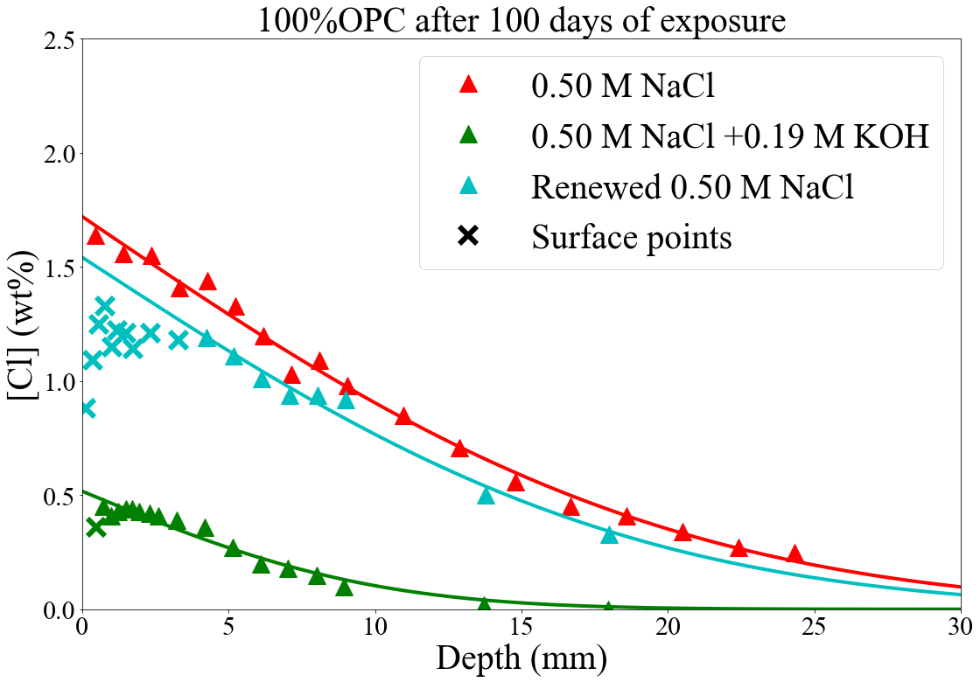
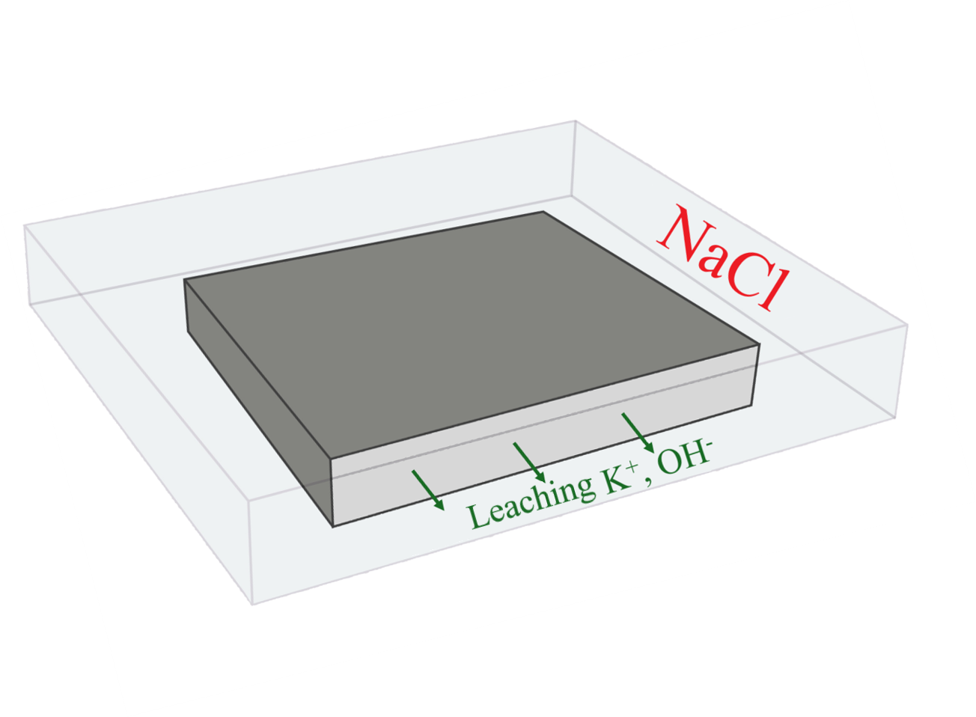
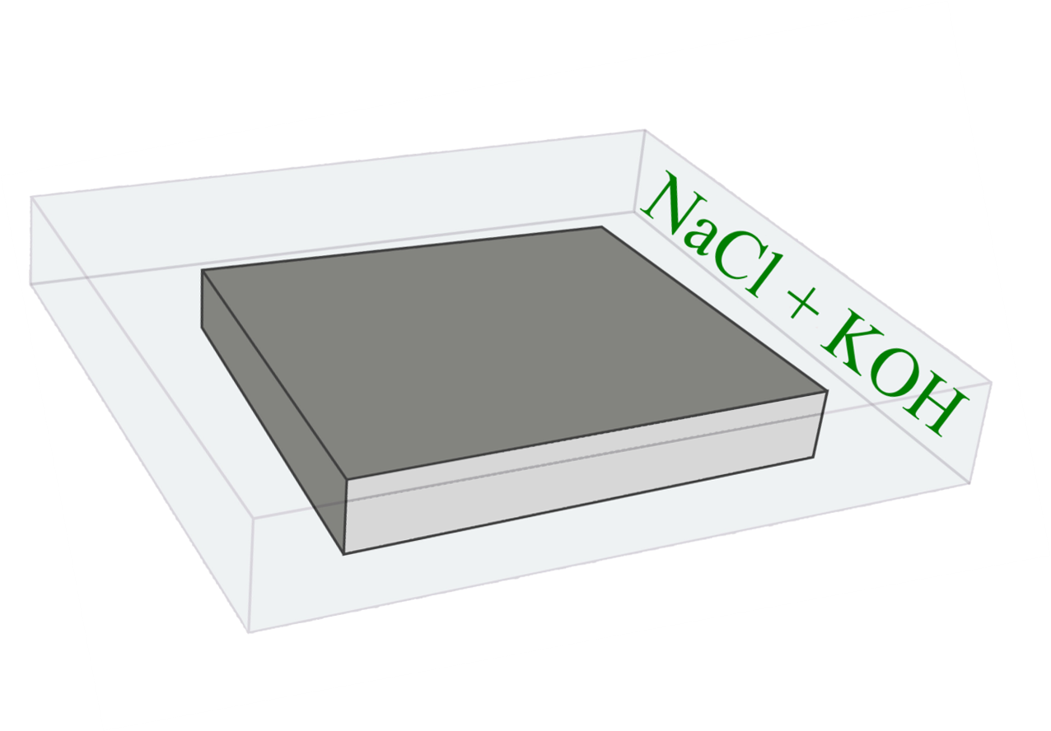
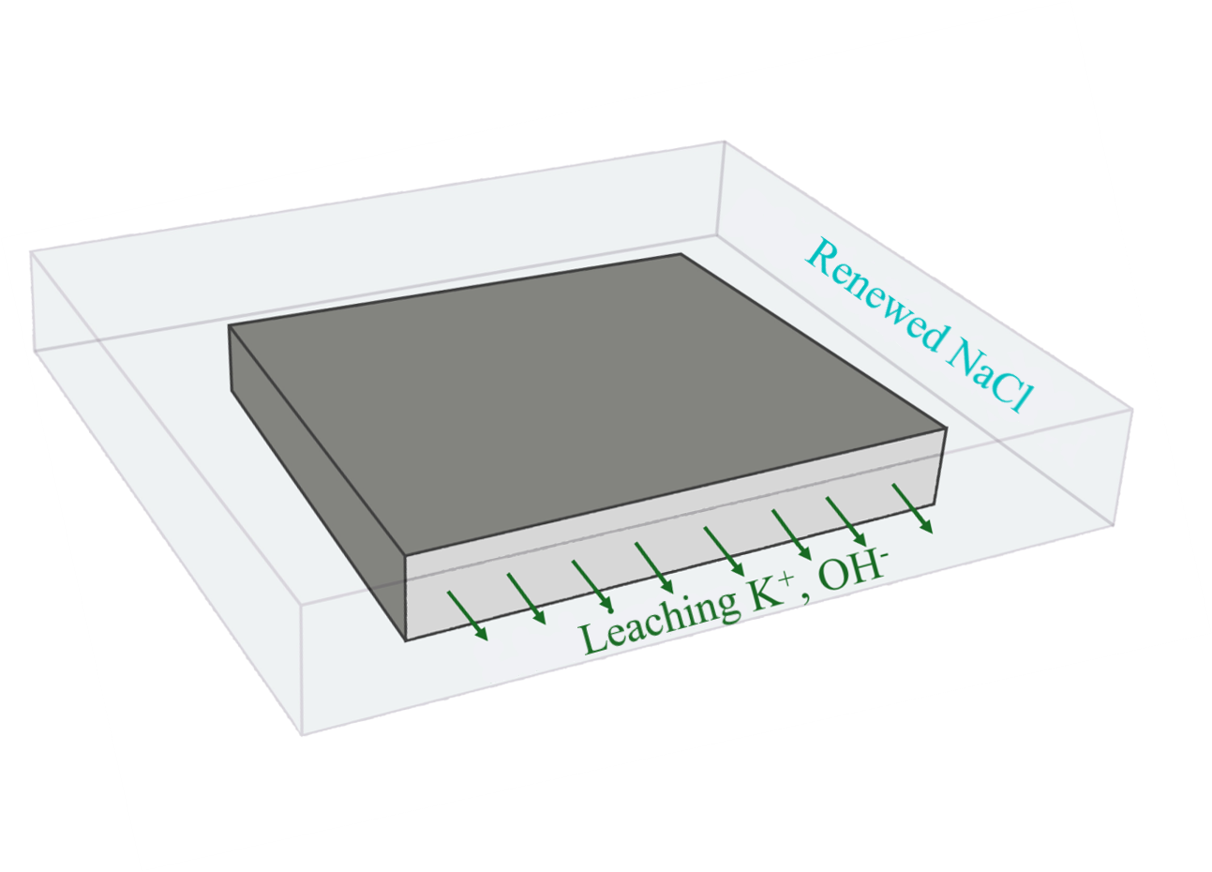
Main findings:
Adding KOH to decrease leaching impacts decrease the chloride intensity and penetration depth
Renewing the exposure solution to increase leaching does not impact the chloride profile
Notes:
Objectif carboneutralié

Slide 7
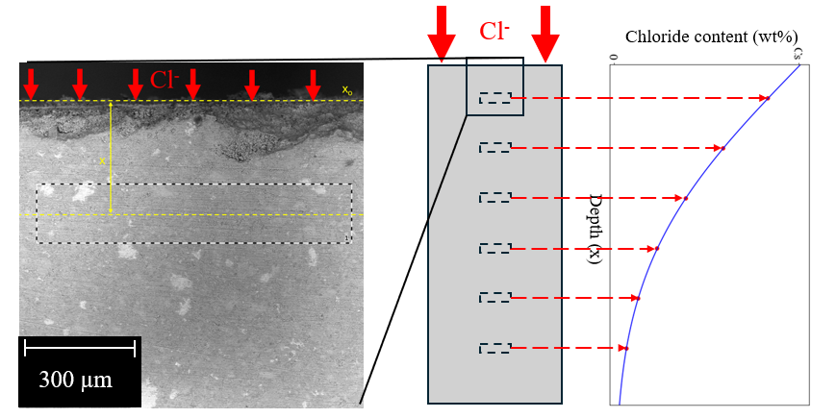
Sample preparation and chloride measurement:
A slice is collected and prepared for VP-SEM EDS (manual polishing, hydration stoppage). The chloride profile is measured using a VP-SEM EDS at 0,1Pa to ensure evacuation of the charges.
Notes:
Objectif carboneutralié

Slide 8
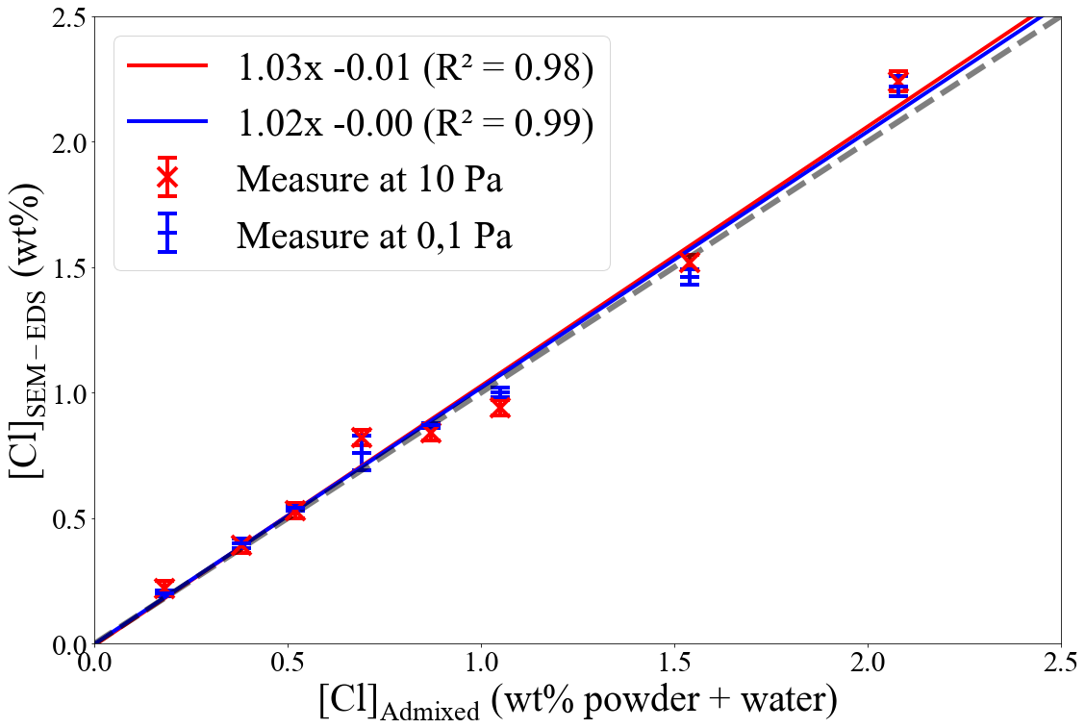
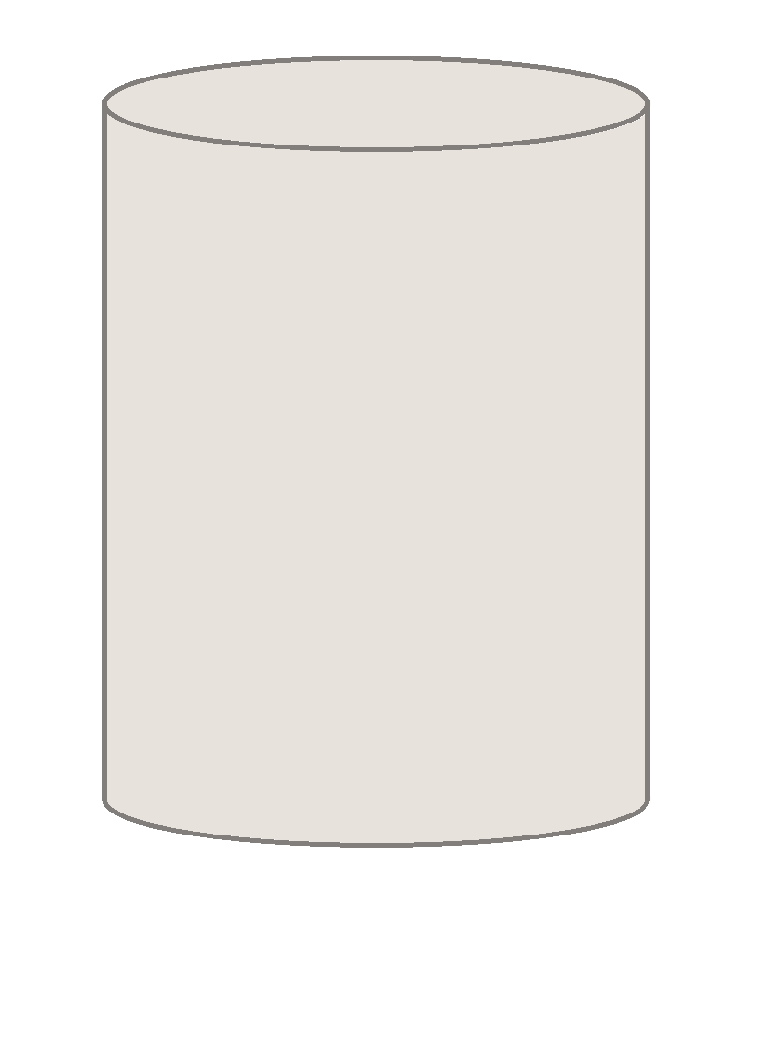
Main findings:
Calibration using samples of known concentration of chloride reveals that VP-SEM-EDS is directly quantitative
100%OPC + x%NaCl
Notes:
Objectif carboneutralié

Slide 9
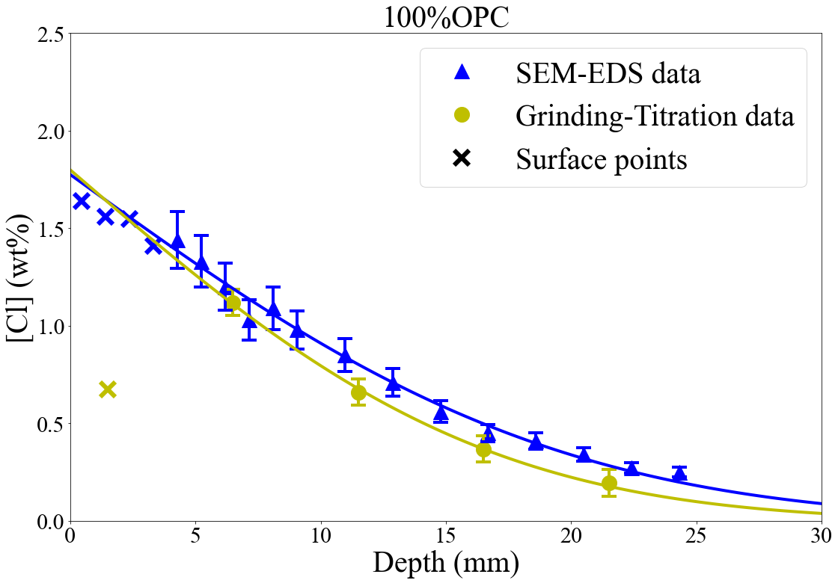
Main findings:
Very similar chloride profiles are obtained using the common method (ASTM C1152) and the SEM-EDS method
The SEM-EDS method is simpler and time-saving and can reach lower spatial resolution
Notes:
Objectif carboneutralié

Slide 10
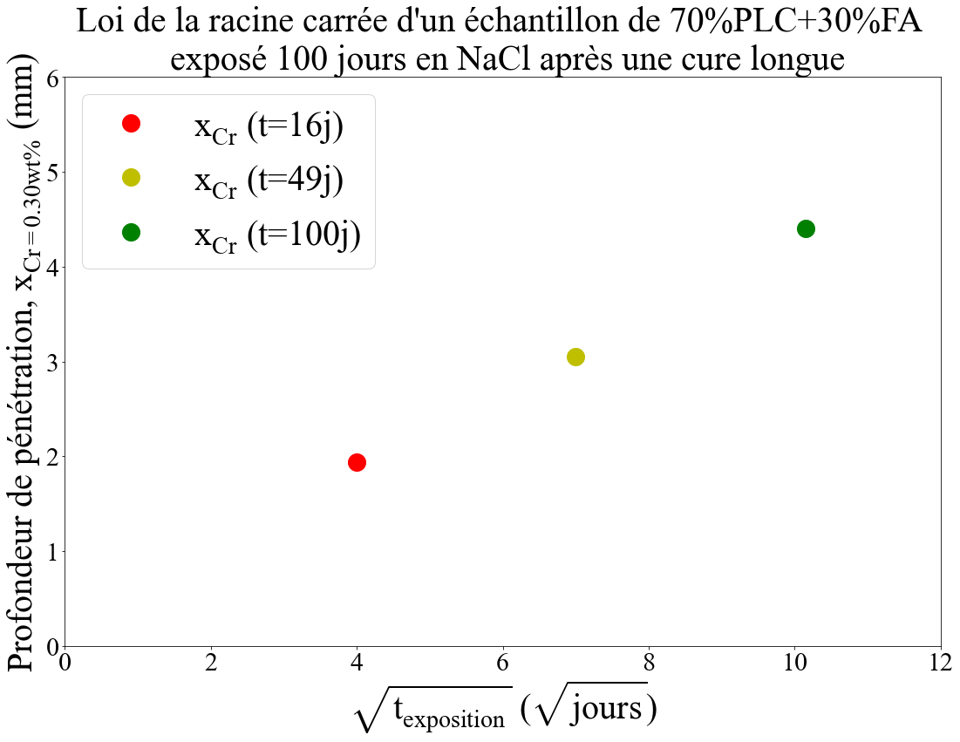
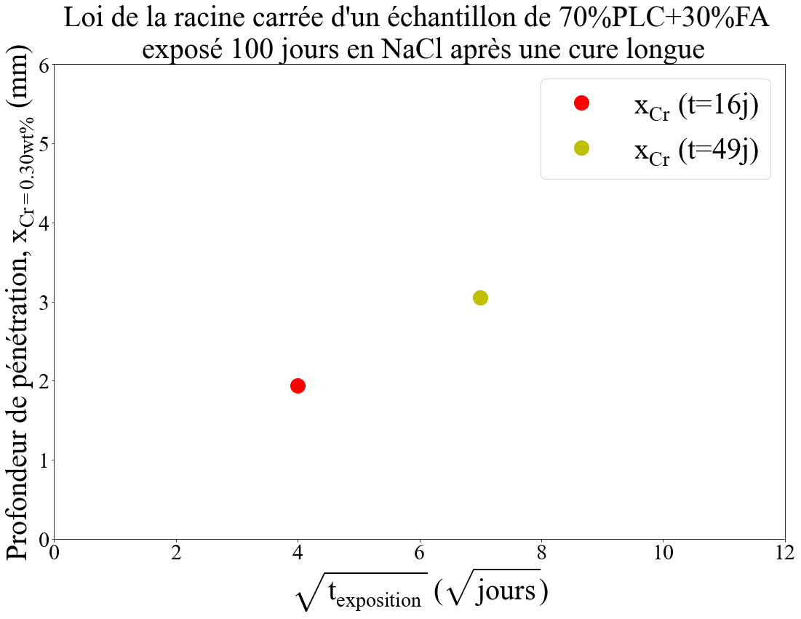
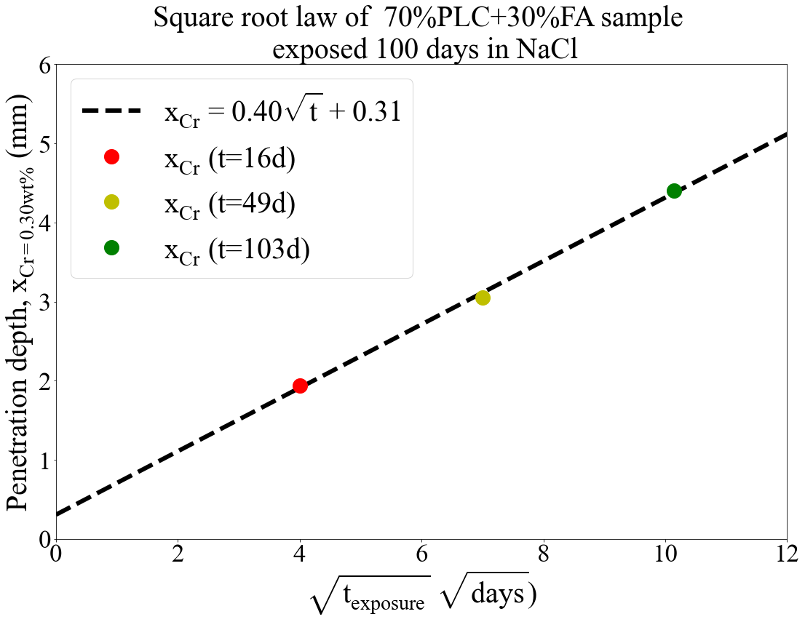
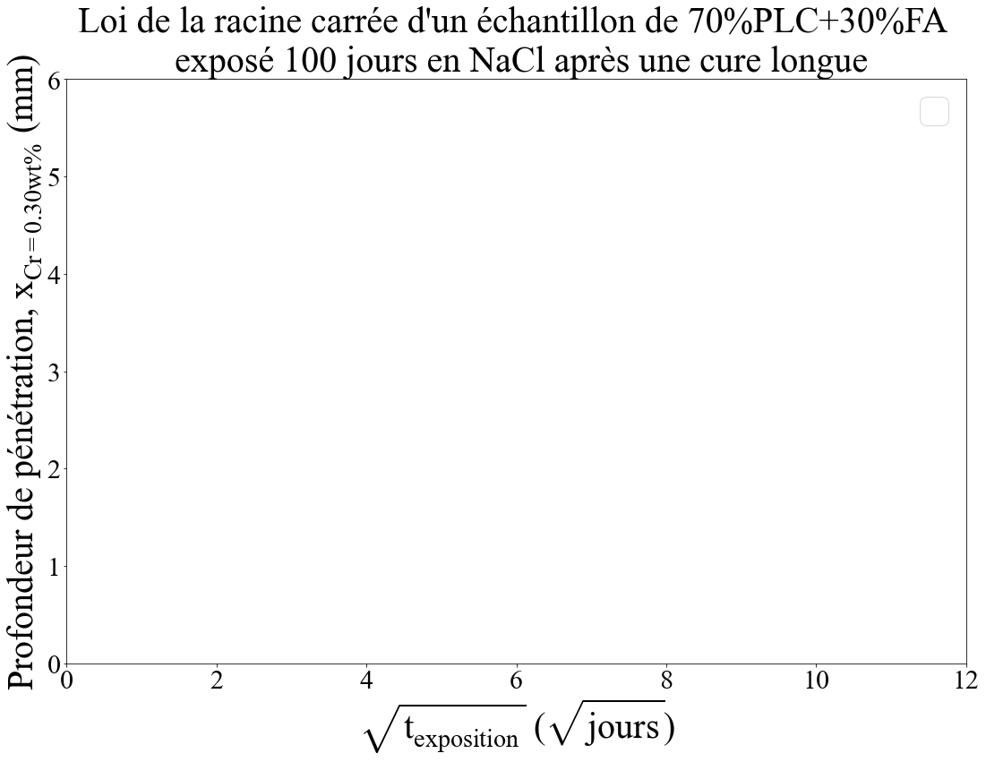
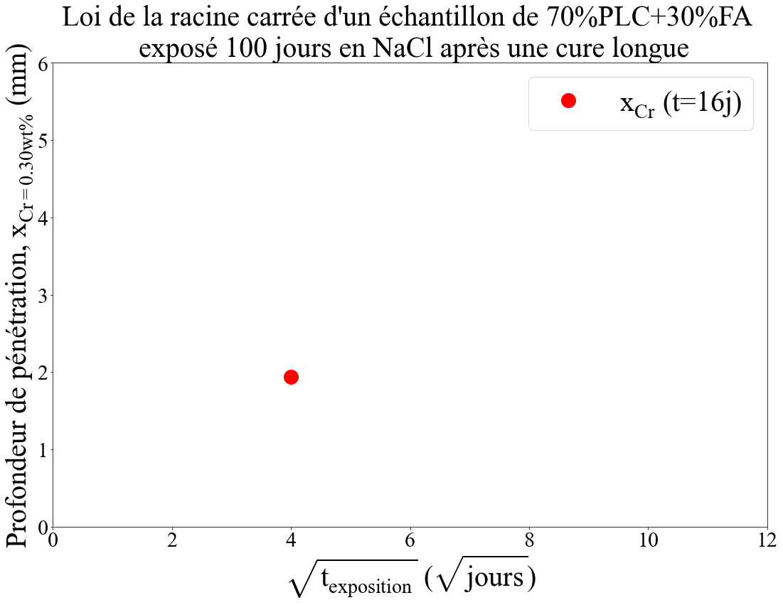
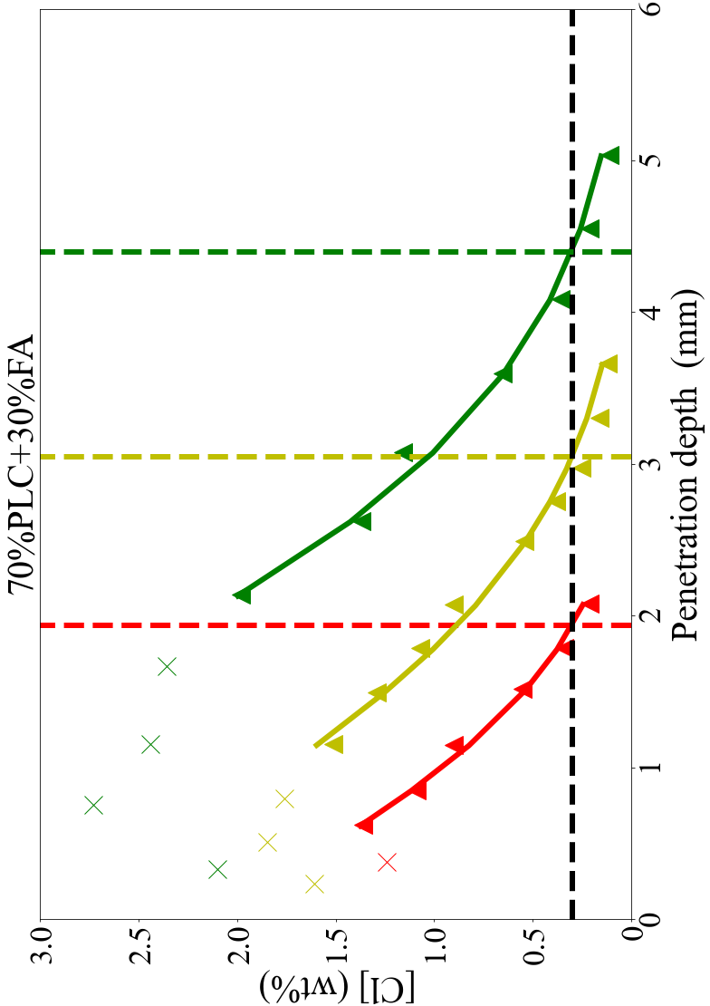
Profile analysis:
A reference chloride concentration is chosen and the evolution of the depth where it is measured in the sample is followed. A square root relationship is obtained that allows for future prediction
Notes:
Objectif carboneutralié

Slide 11
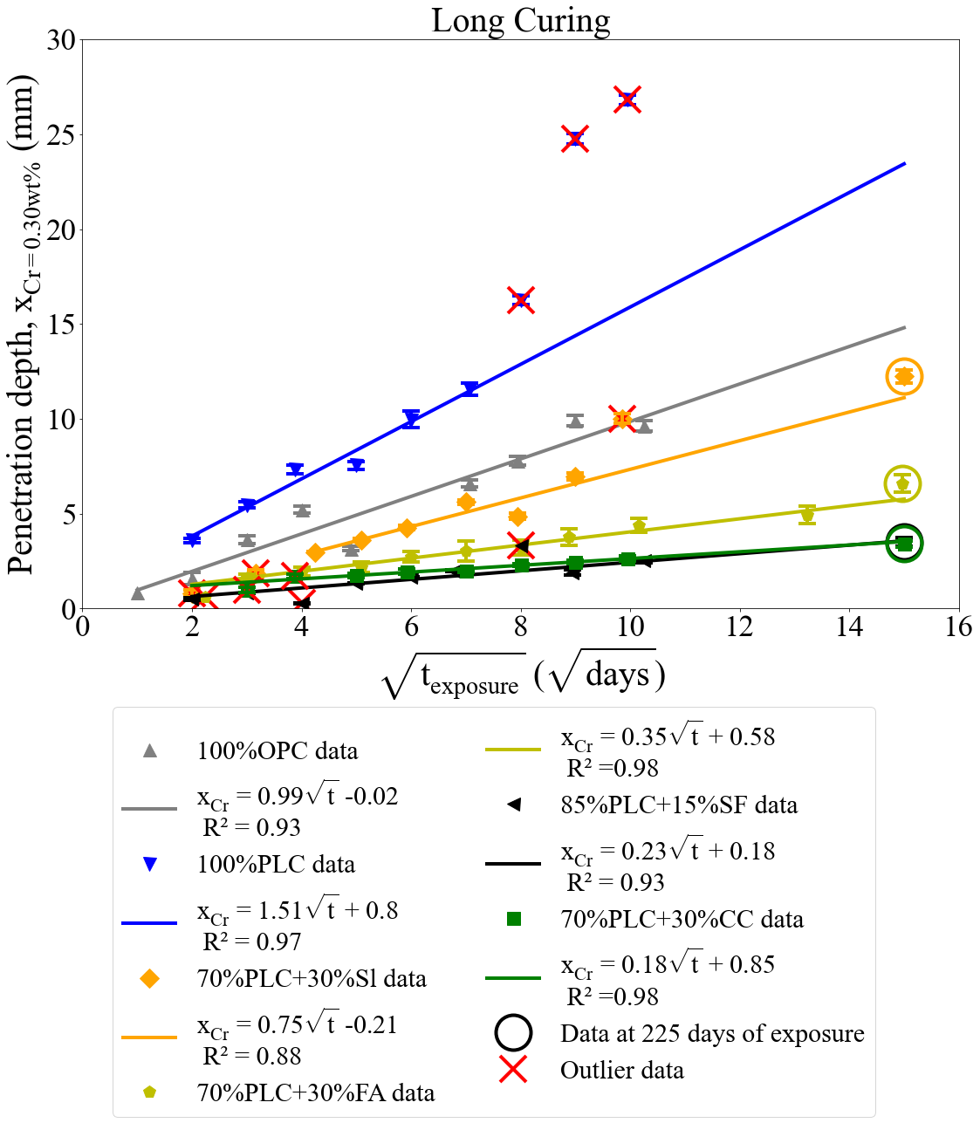
Main findings:
Prediction of the penetration depth at 225 days within 100 days with 10% error
Notes:
Objectif carboneutralié

